Slide 1
Szkolne Warsztaty Astronomiczne
Grzegorz Żakowicz i Katarzyna Struss, LO Nr XIII we Wrocławiu,
Warszawa, 8.11.2014
Notes:
Good morning. My name is Grzegorz and I would like to tell you about the School Workshops on Astronomy which are a friendly introduction
to astronomy and natural sciences for secondary and high school students.
This idea originated over a mug of beer when a few colleagues from the Astronomical Institute,
a high school teacher tried to find the way to revive the methods of teaching science at schools,
by moving it to the green and clean environment, far from the industry, to a place where the sky is dark.
And we managed to do that in November 2007!

Slide 2
Główne założenia:
popularyzacja astronomii i nauk przyrodniczych
budowa umiejętności pracy w grupie
promowanie i popularyzacja ochrony przyrody
Notes:
These are our main aims:
We put strong emphasis on popularisation of astronomy…
We want to develop at our students the skills which are not often used in typical methods of teaching in Poland, namely, the…
Finally we pay a lot of attention to the beauty of the area where the workshops are held and to …

Slide 3
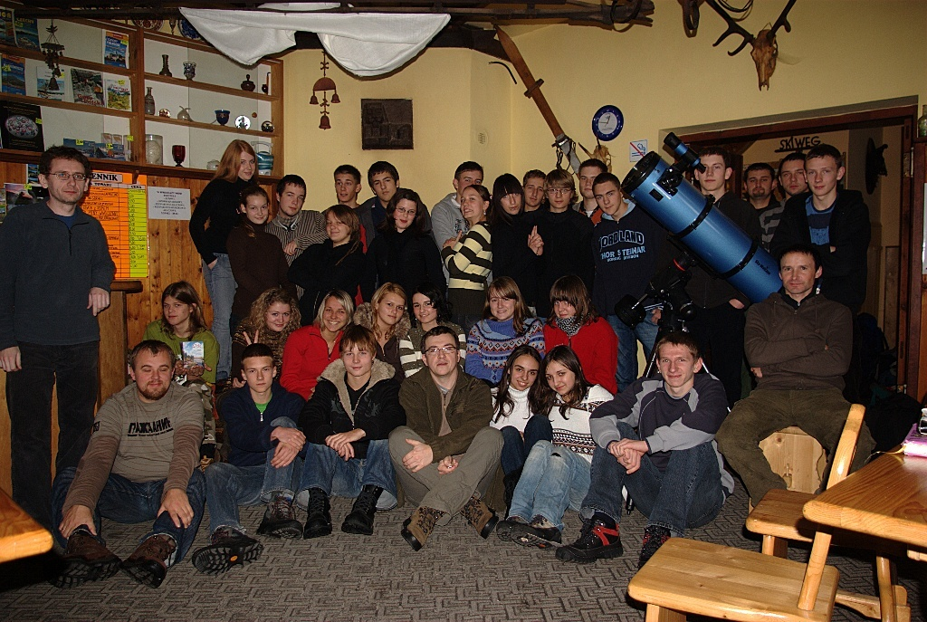
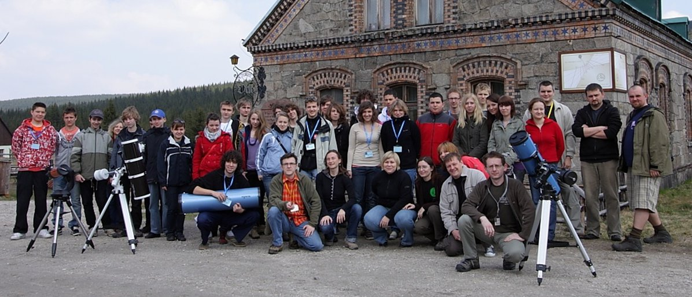
Kadra: pracownicy naukowi IA i IF UWr., nauczyciele z wrocławskich liceów i gimnazjów, pracownicy Nadleśnictwa Świeradów, goście…
I SWA – 5-7.11.2007,……….XIV SWA 1-3.10.2014
Notes:
This is the picture from first edition of workshops,
You can see them hightlighted

Slide 4
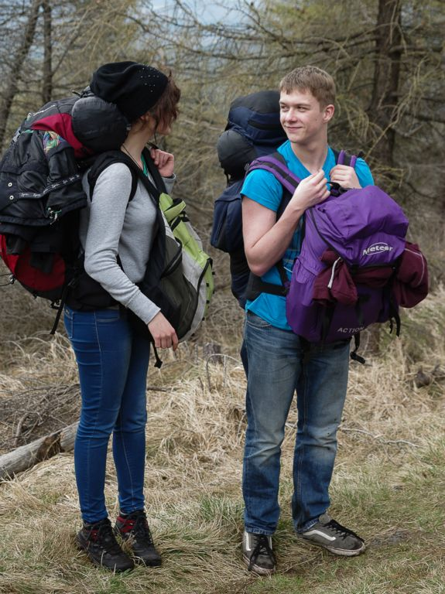
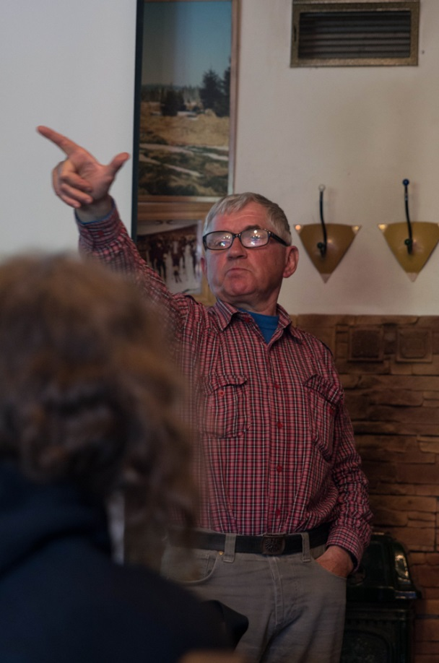
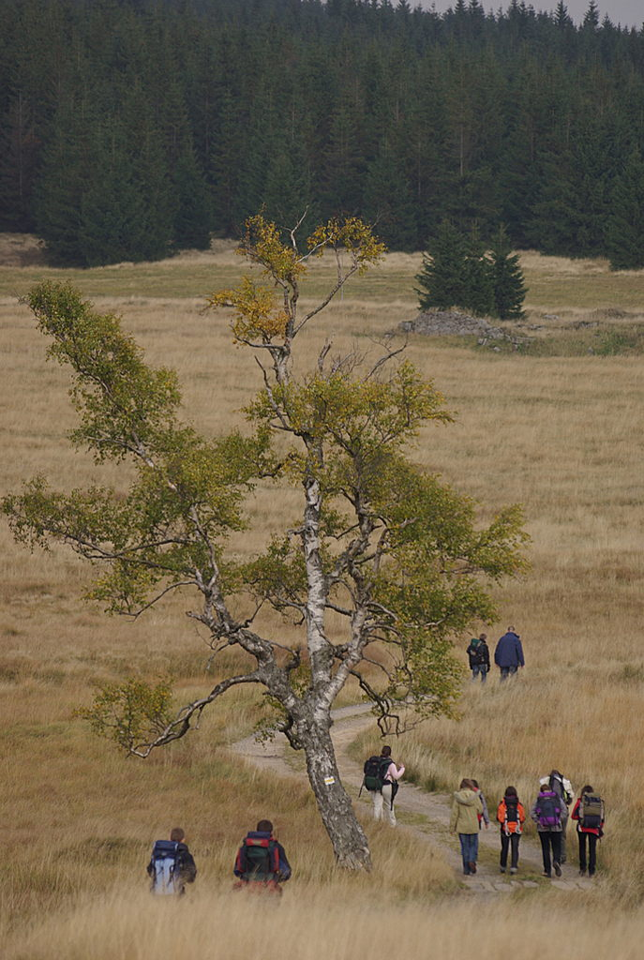
W Kosmos na piechotę …
Notes:
SWA are full of different activities.
First, we need to reach the venue which is the Orle Tourist Station in the Izera Mountains
Usually we walk for around 15 kilometers from the place at which we get off the bus to the Orle Tourist Station where the scientists, teachers and the telescopes await us.
As you can see not everybody can reach the target
When we arrive at the place we have an hour or two of free time and then, the lectures begin.

Slide 5
Dwie edycje:
jesienna – warsztaty, wykłady, astrofotografia
wiosenna – uczniowie przygotowują zagadnienia pod kierunkiem opiekunów (od lutego do kwietnia)
Każda sesja ma swój temat, np. „Podróż na Marsa”, „Życie”, „Koniec świata” itd.

Slide 6
Mars
Dlaczego Mars?
Start i powrót
Czego szukamy?
Jak przetrwać?
Inne
Lot
Warunki lokalne
Notes:
The idea of each workshop is the following:
First of all we form 7 teams 4 person each, which are given different subjects to work on.
Wymieniamy:Life,water,resources, settlement, psychology, cosmic weather, engines, comunication.
Each team has a supervising scientist from Astronomical Institute or a teacher who helps student prepare their talks, experiments, etc.
Later on the workshop students present the results of their 3-months-long work.
e.g. One of the teams was trying to take a cow to Mars, another was discussing how to make barbecue on Mars.

Slide 7
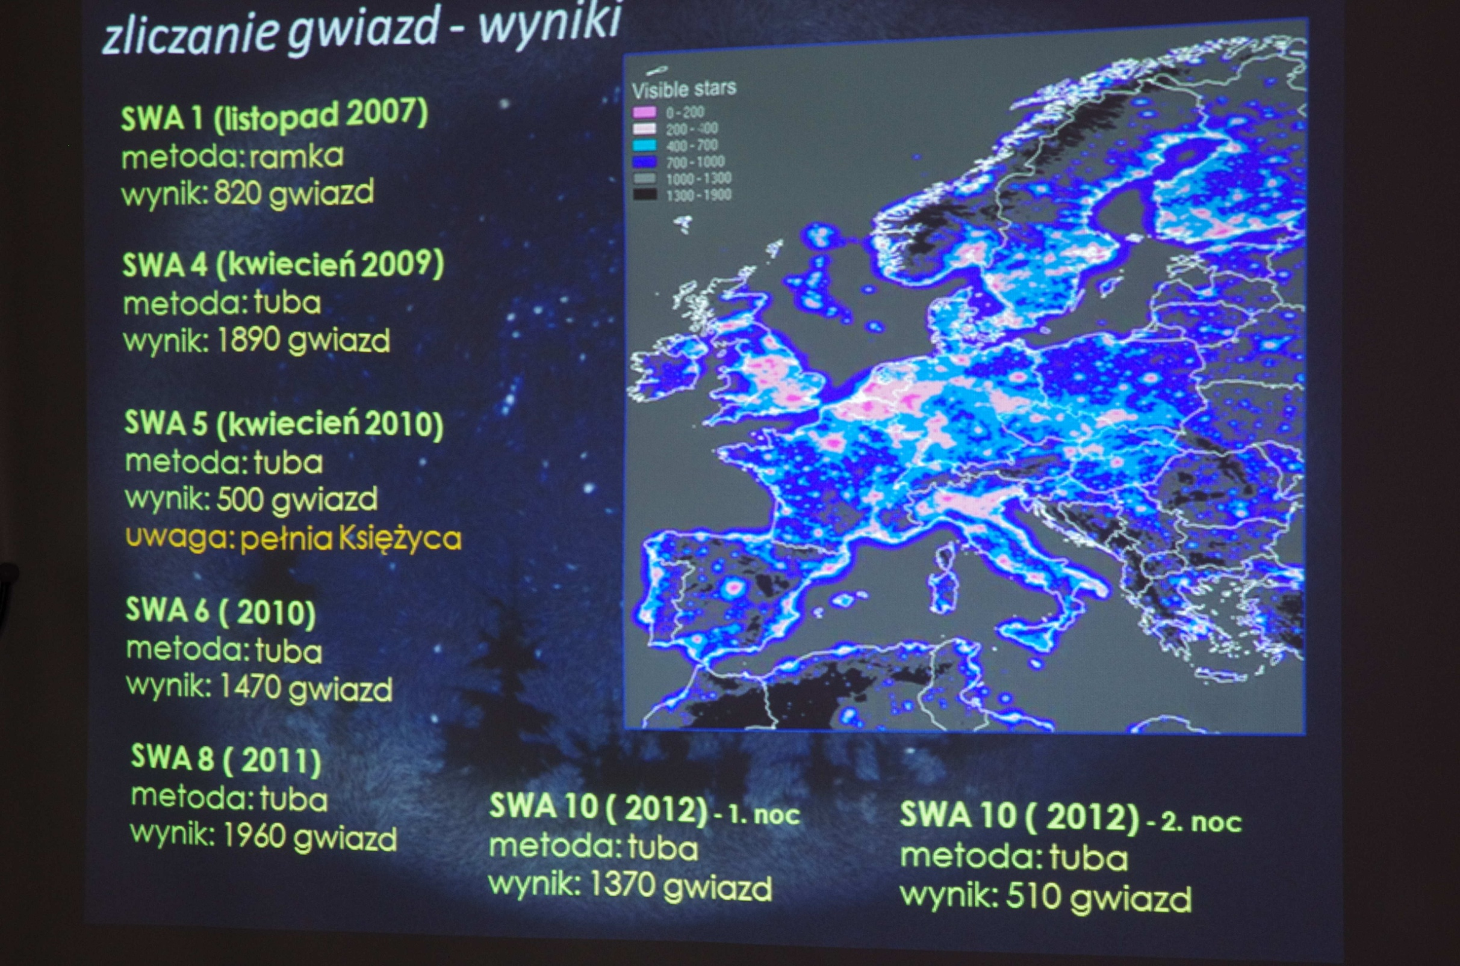
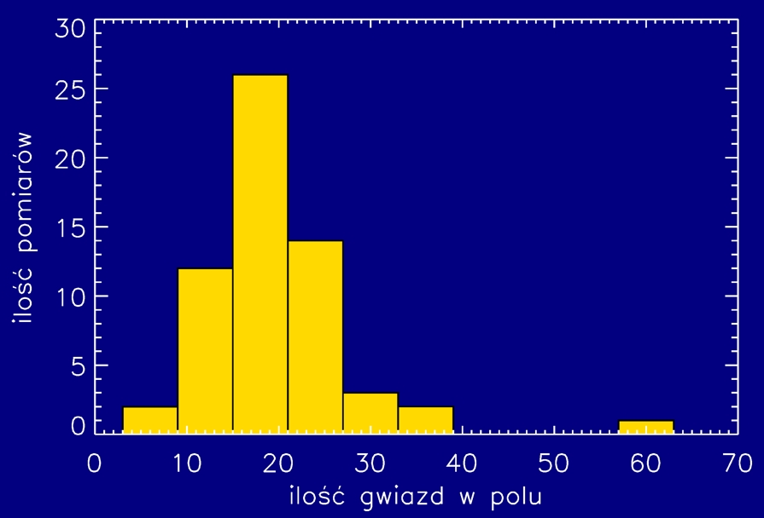
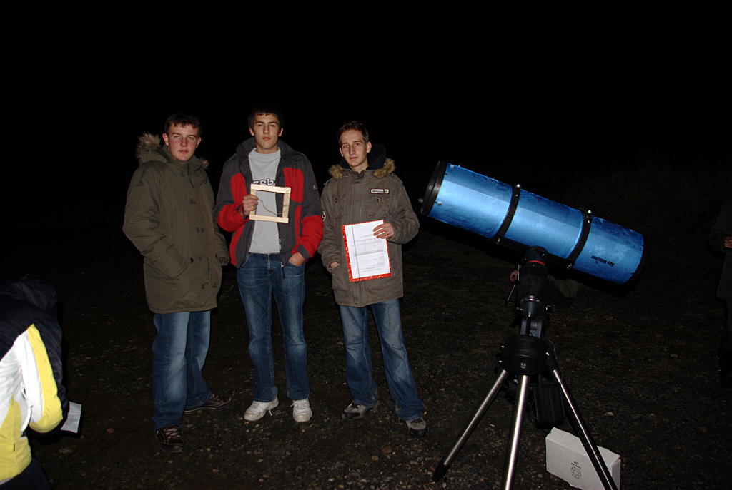
Liczba gwiazd w polu
Notes:
3
-Students count stars- thanks to our measurments, which we carry out on each SWA,the Izera Dark-Sky Park was established,
as one of few in Europe.
In the middle of city we can see about 300 to 400 stars, at Orle Turist Station we can see about 2000 stars.
Students:
set the local noon and the latitude of the Orle Tourist Station using the gnomon and the trygonometric rules.
- perform the measurements which will be used for the future construction of a huge stone ancient-like observatory

Slide 8
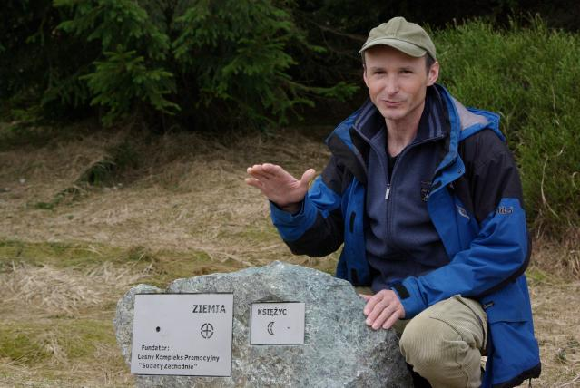
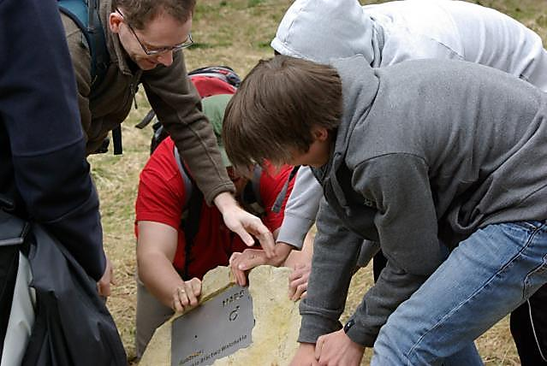

Slide 9
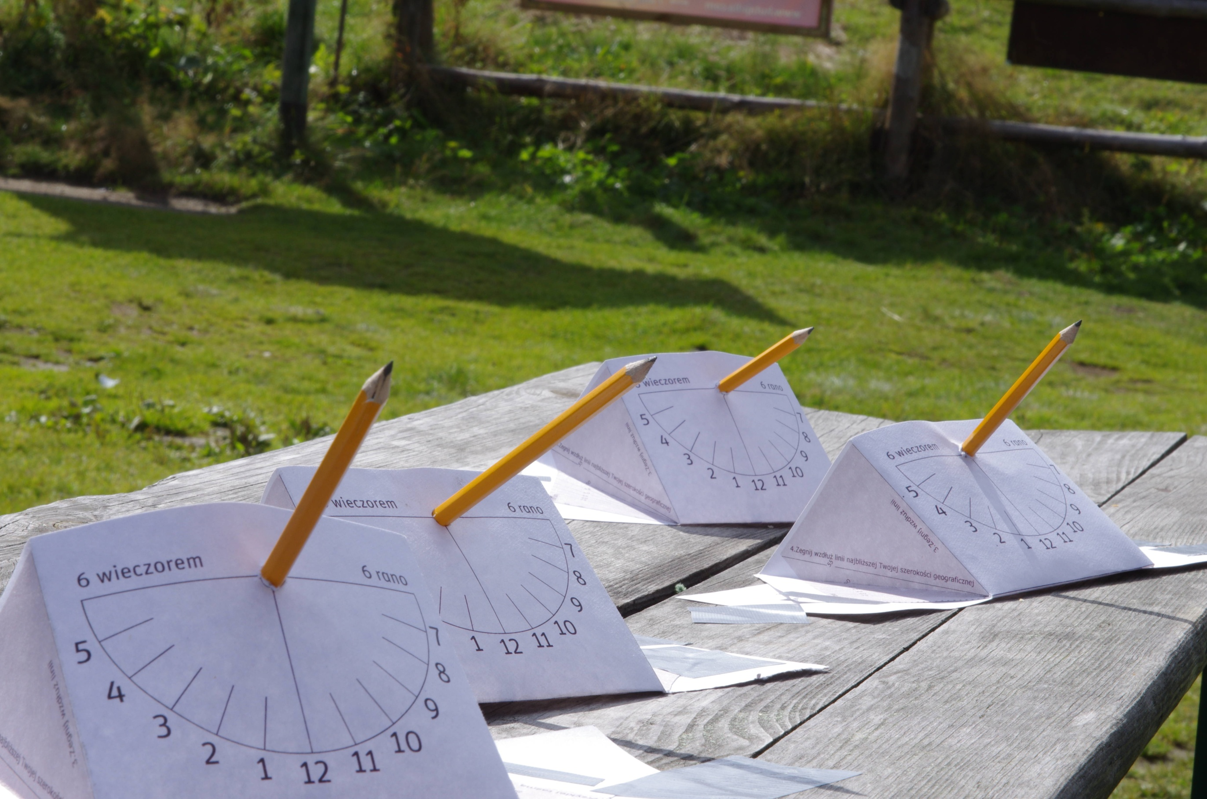
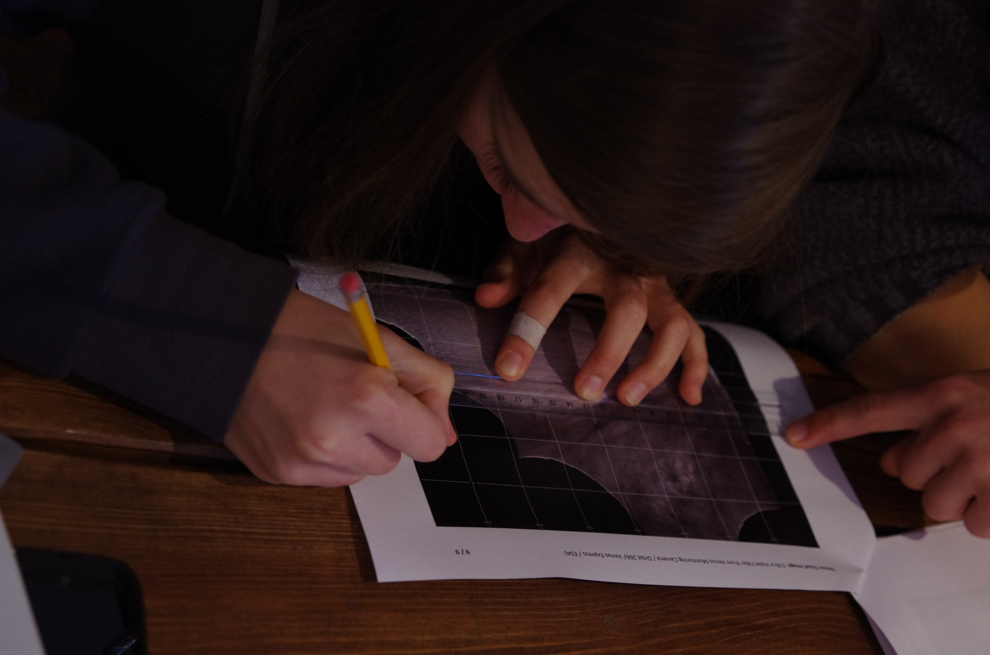
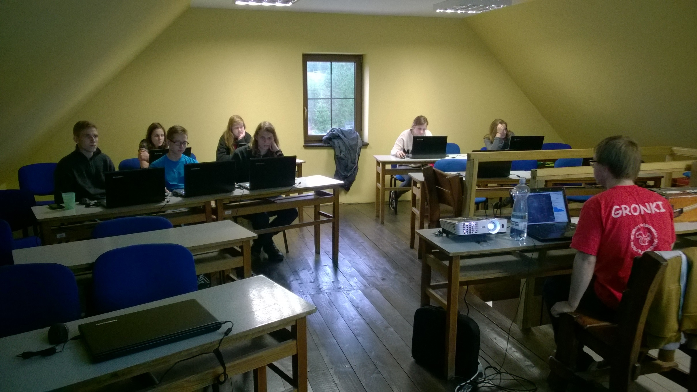
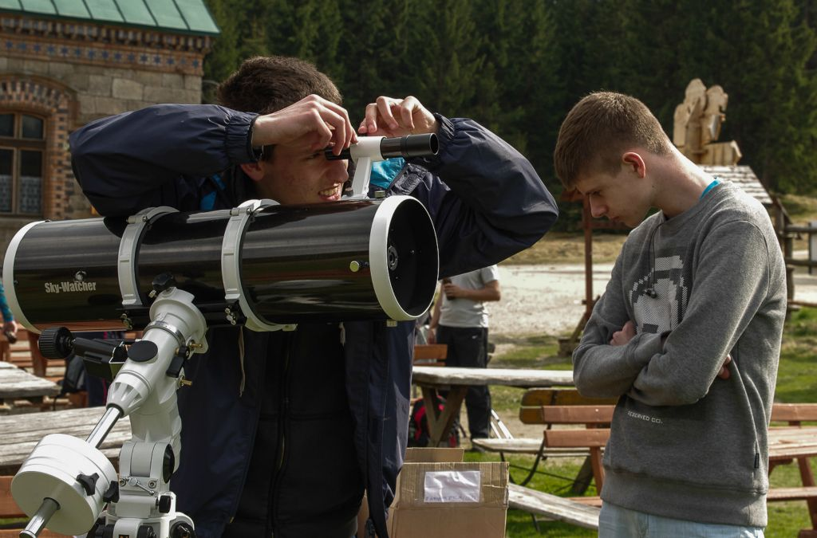
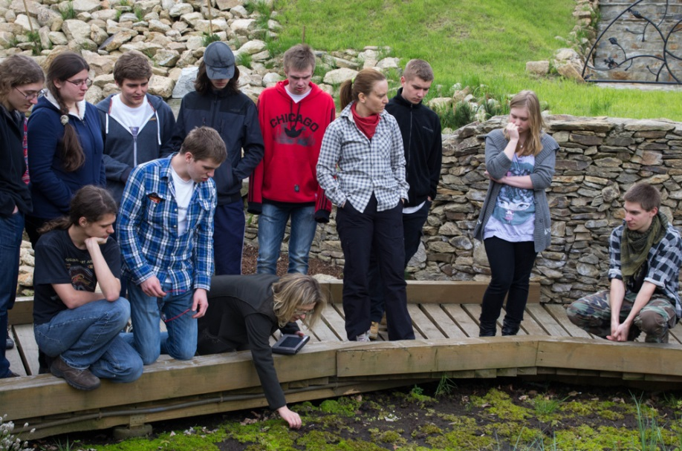
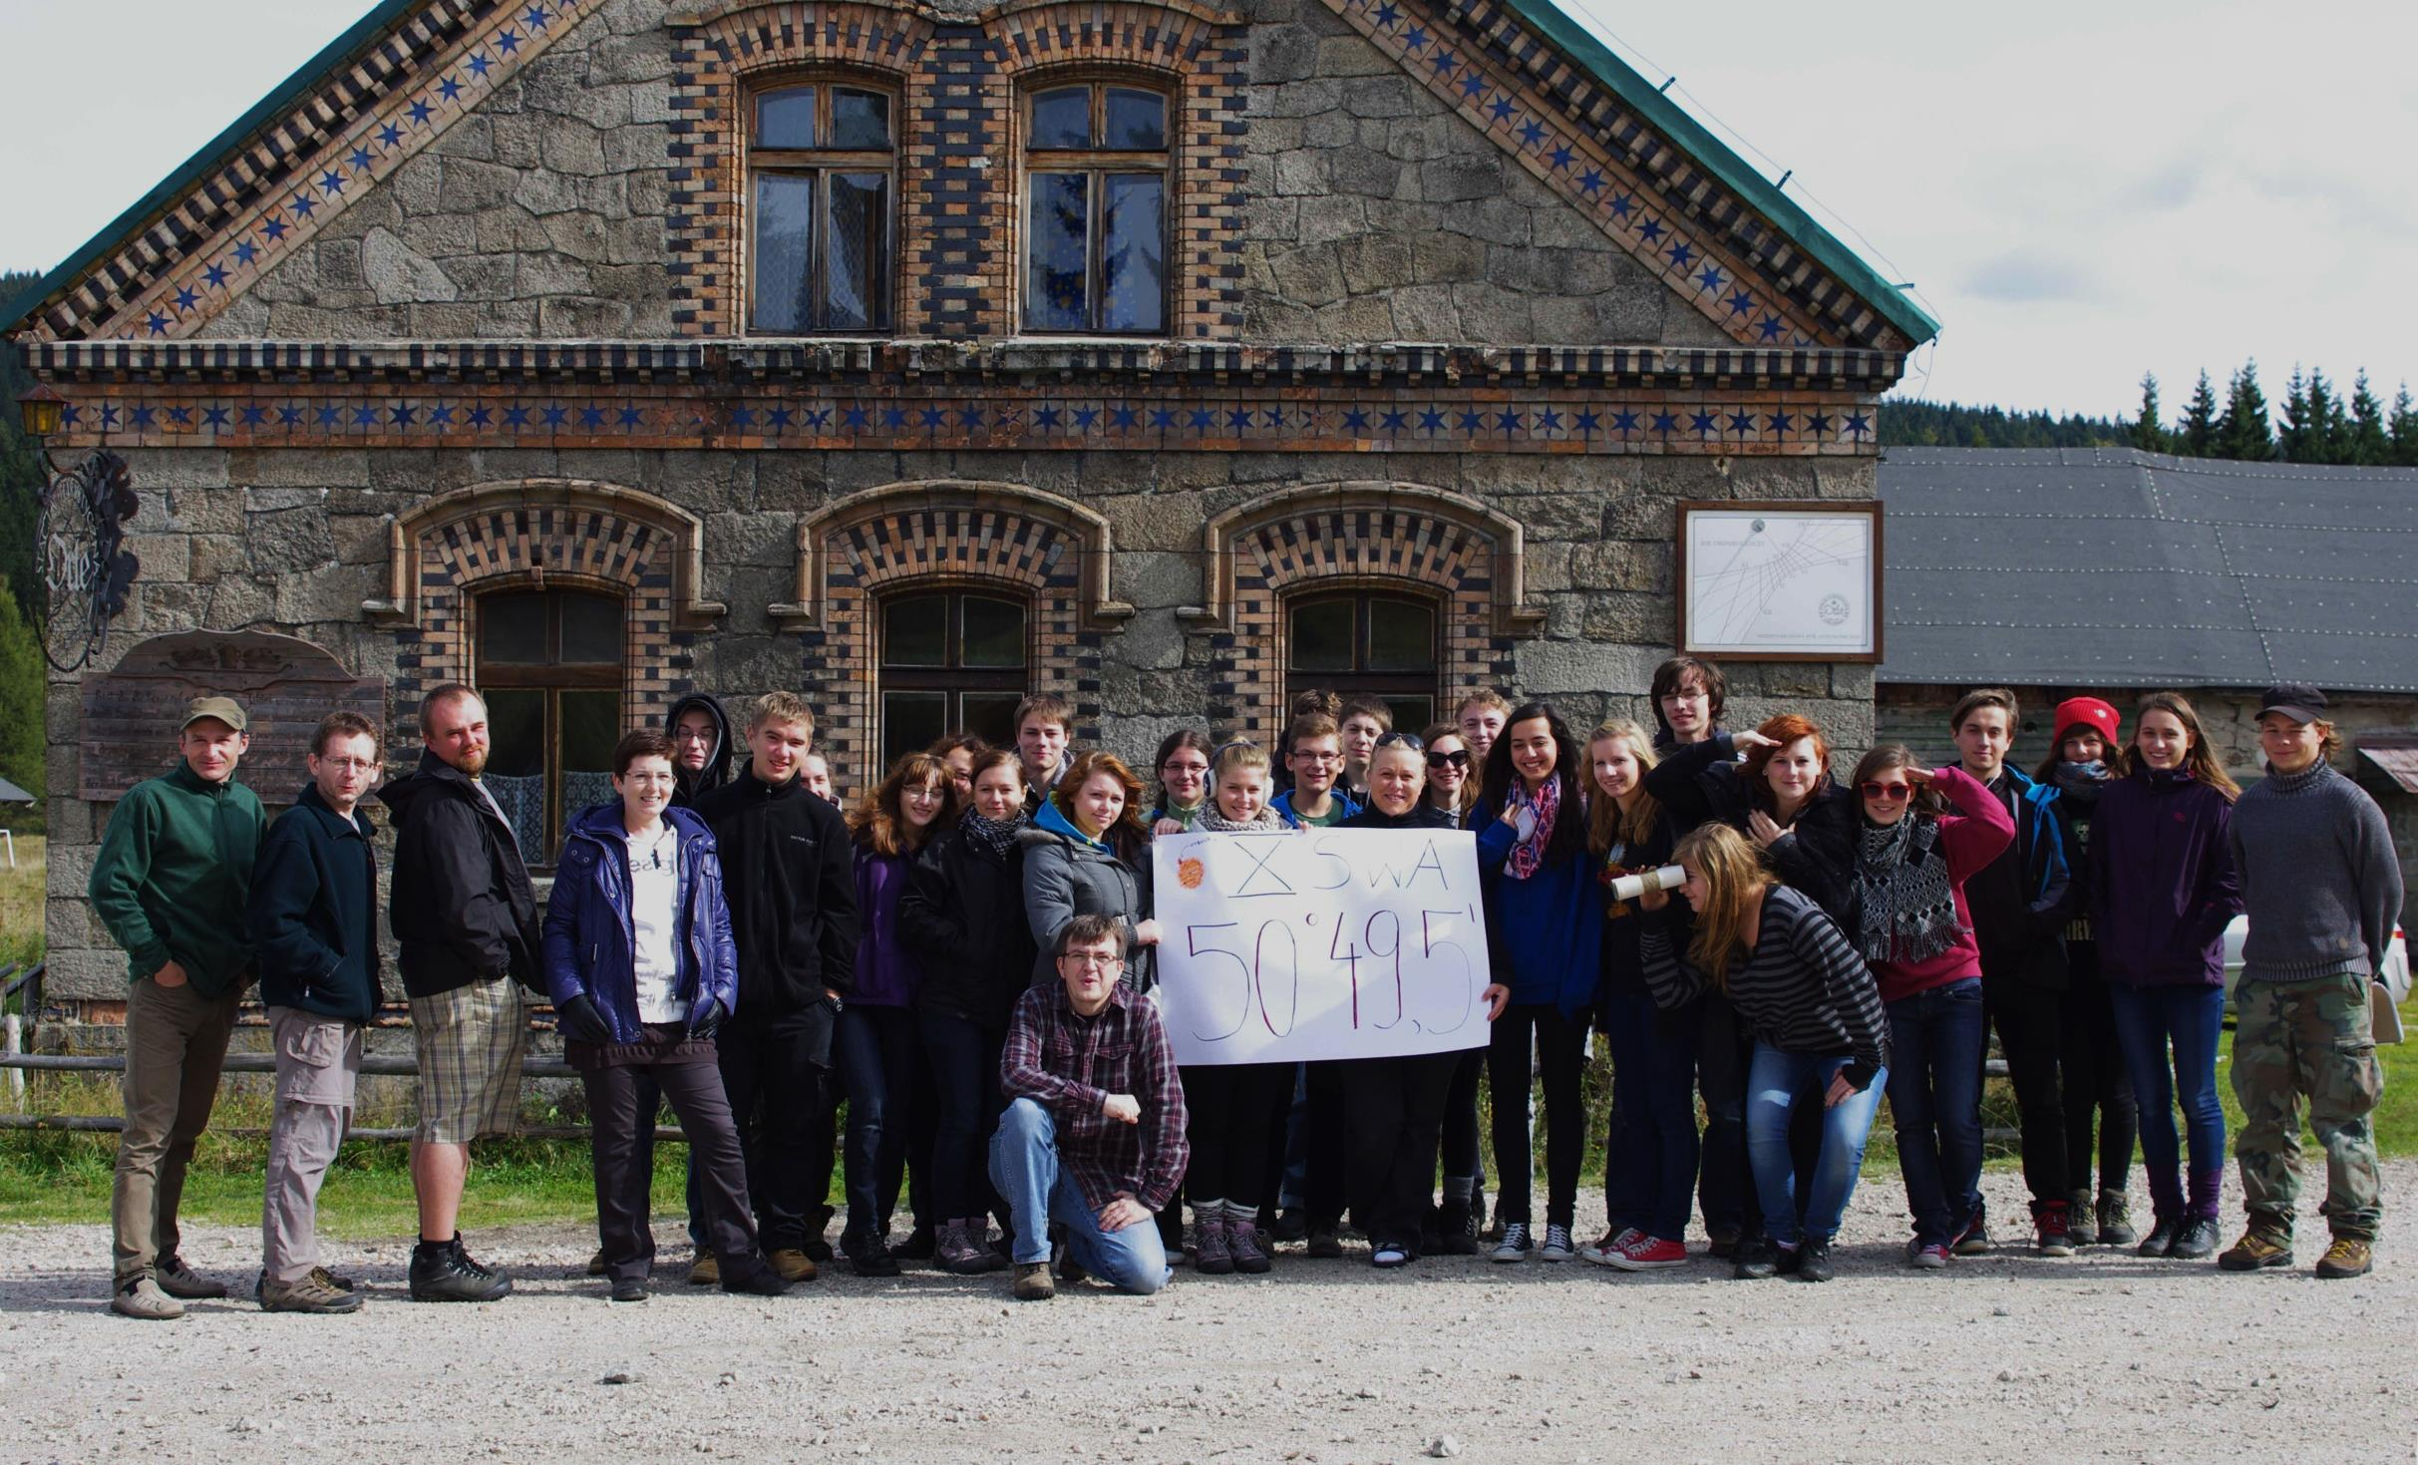
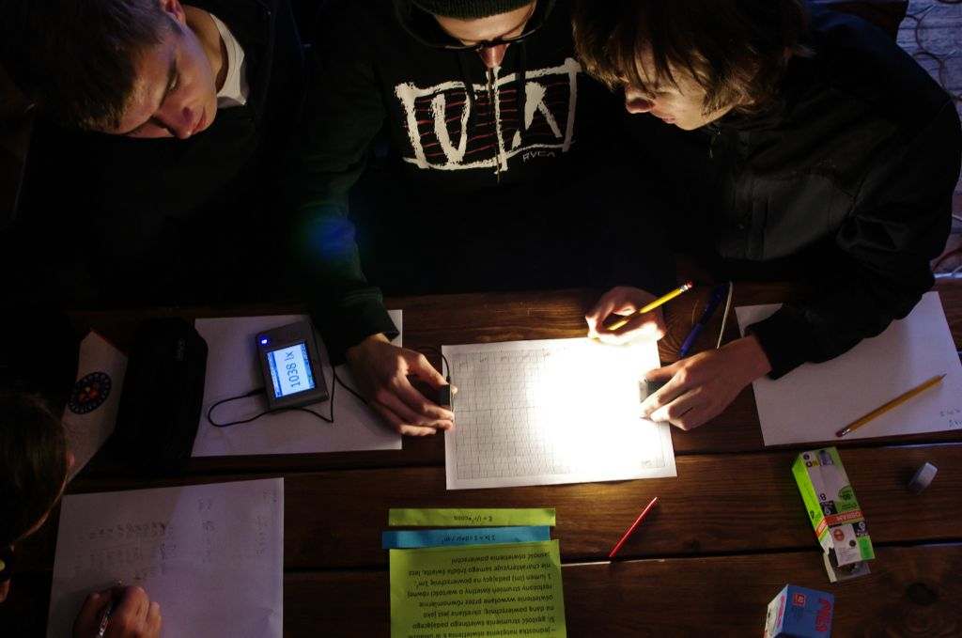
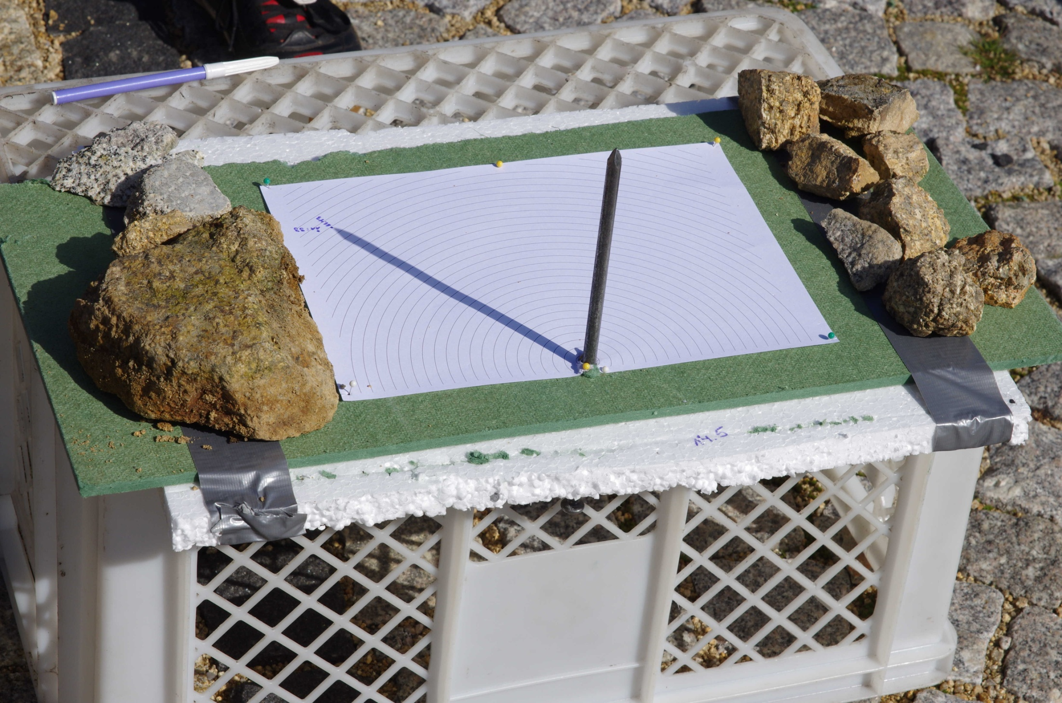
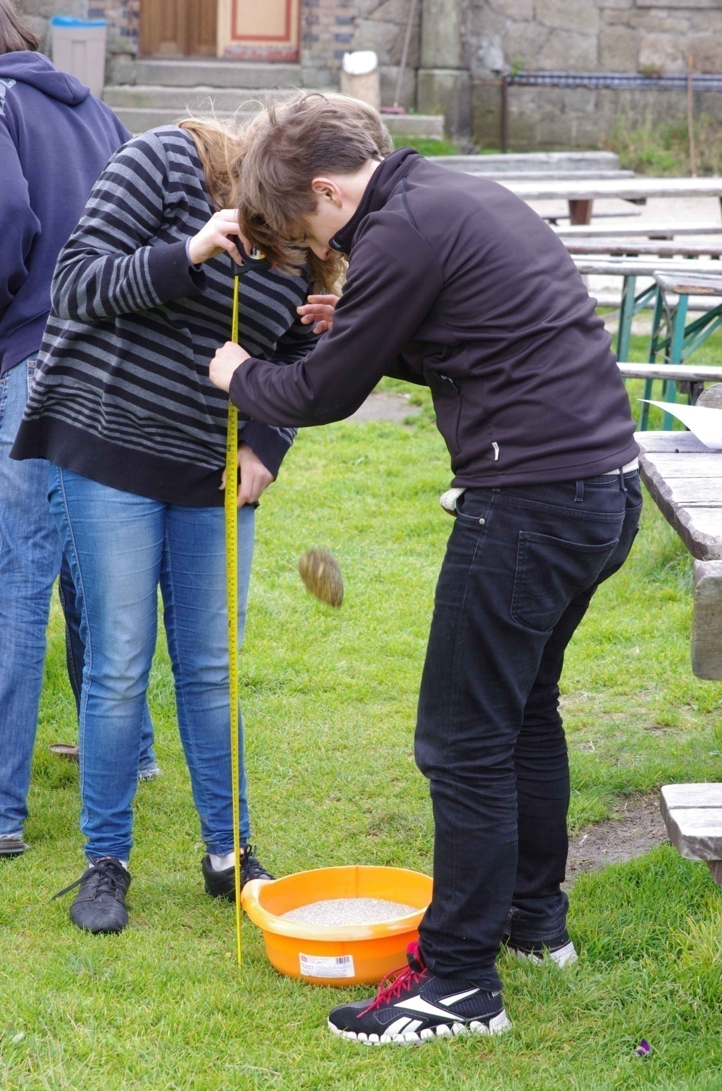

Slide 10
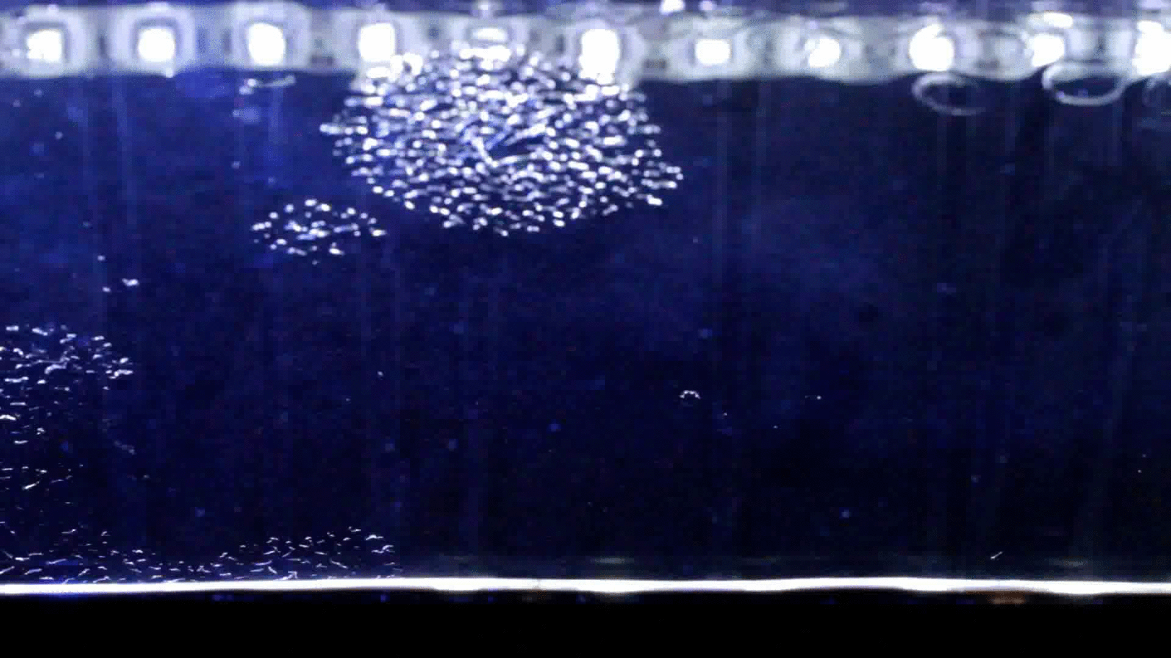
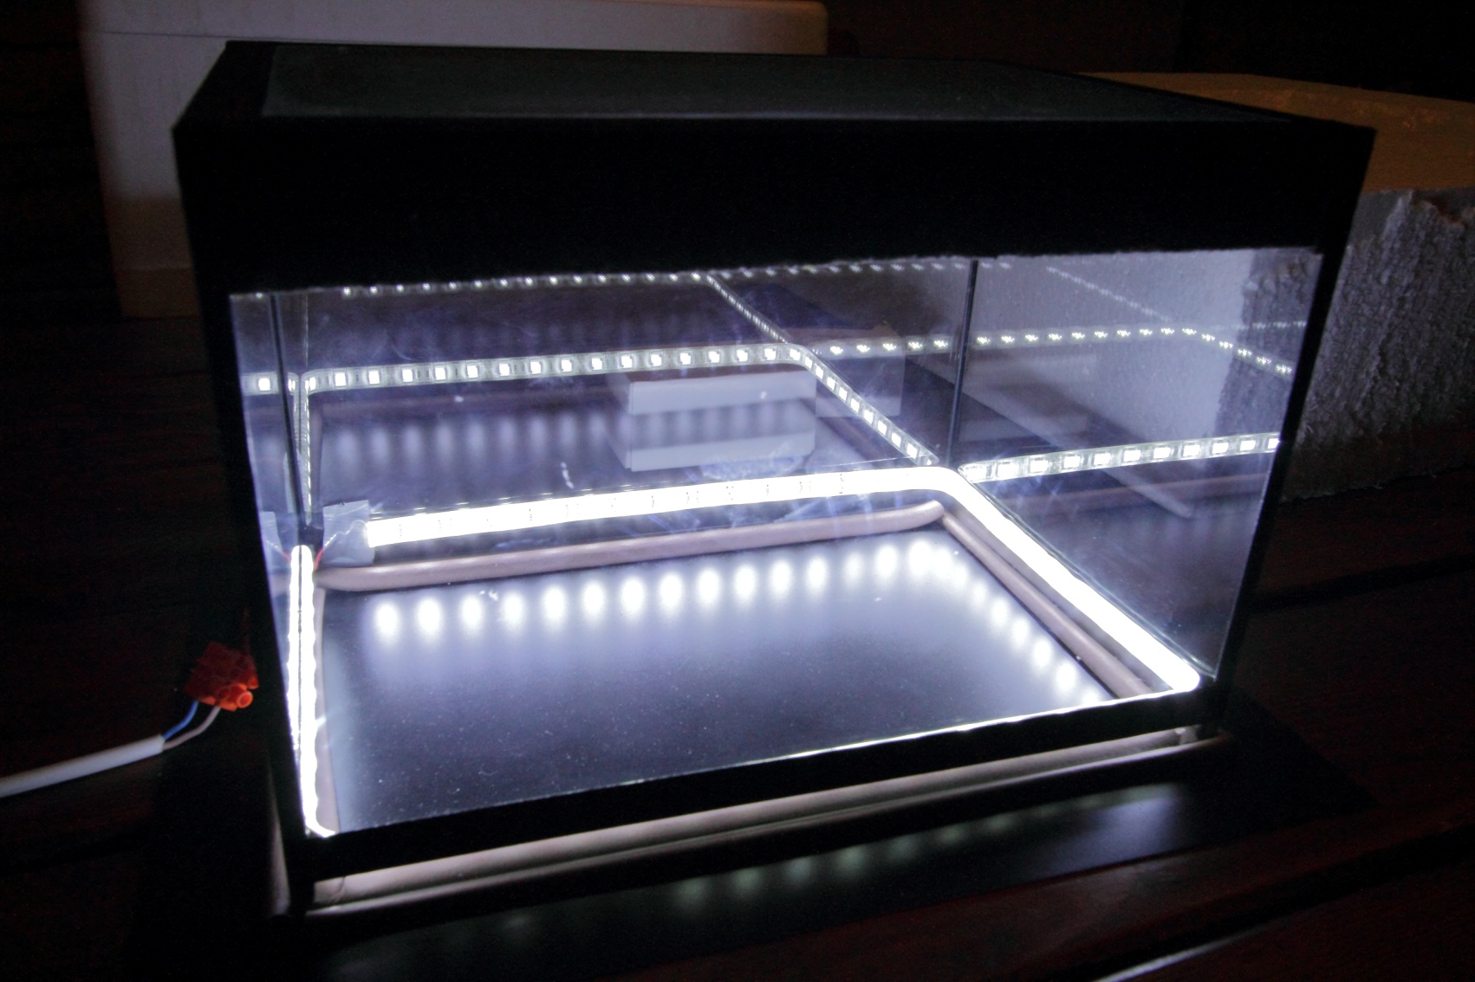
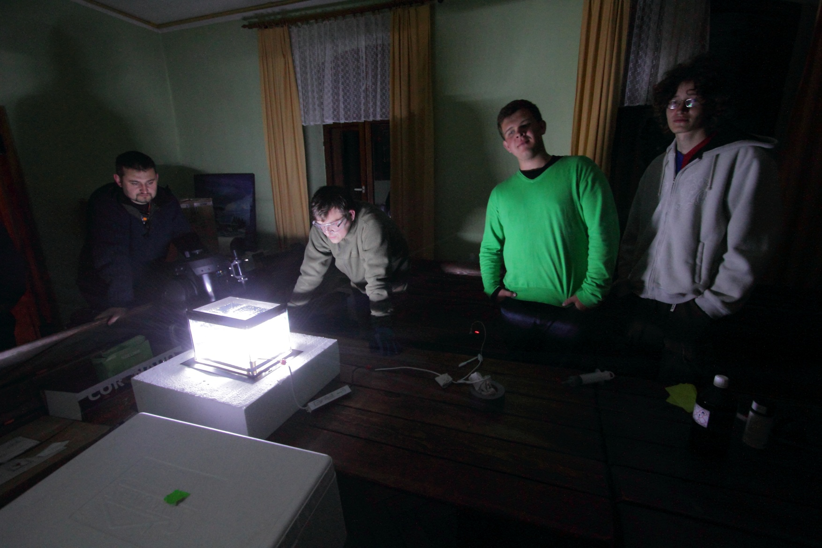
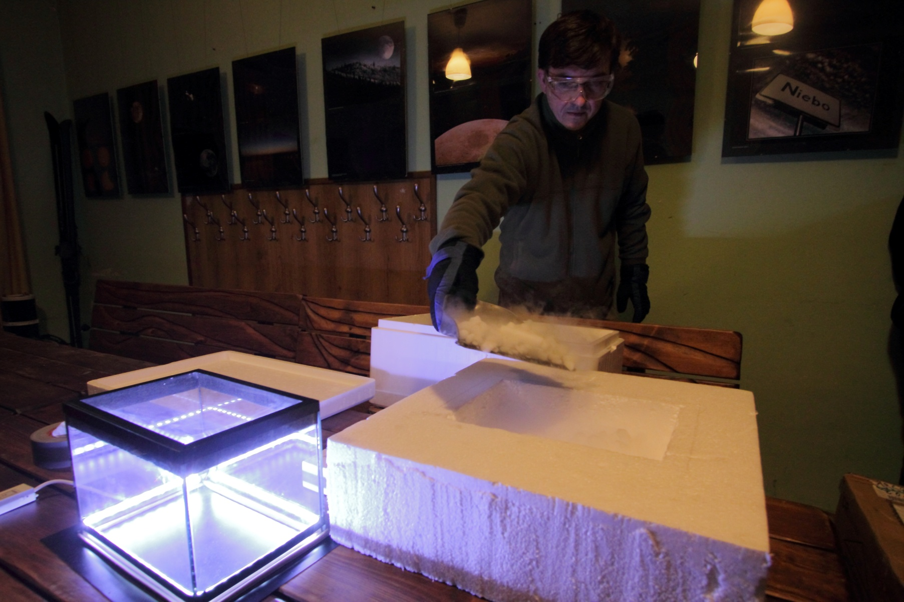
Notes:
4
Students built… This is a glass box with the fog inside, iluminated by led diodes.
Everything inside is very cold due to the dry ice (Dry ice is the carbon dioxide cooled down to the temperature about -80 Celsius degrees)
Here we can see the paths of particles which look like condensation trial behind jet.

Slide 11
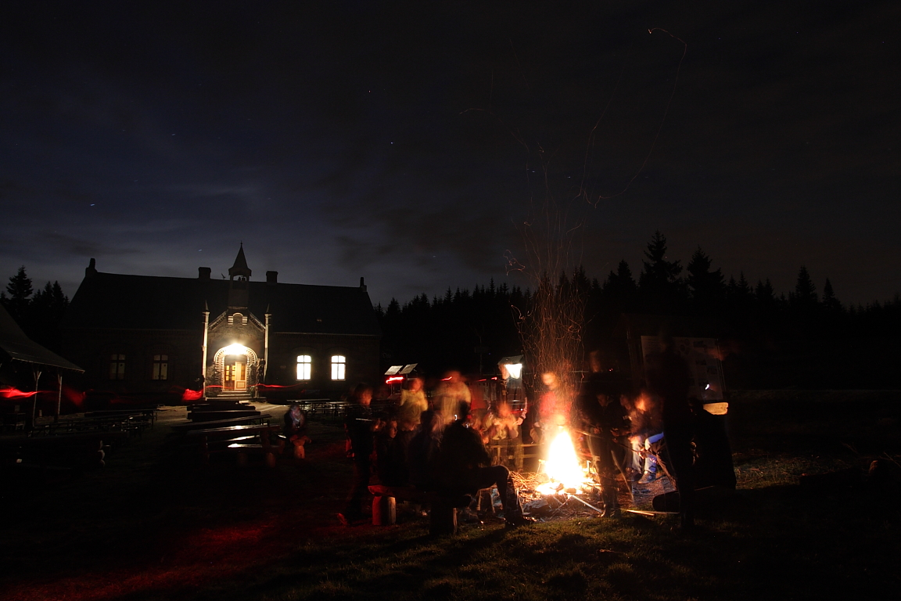
Notes:
The Last night we spend on observing stars and sitting together at the fireplace where we laugh , sing and finally eat sausages (at least this of us, which survived to the end).

Slide 12
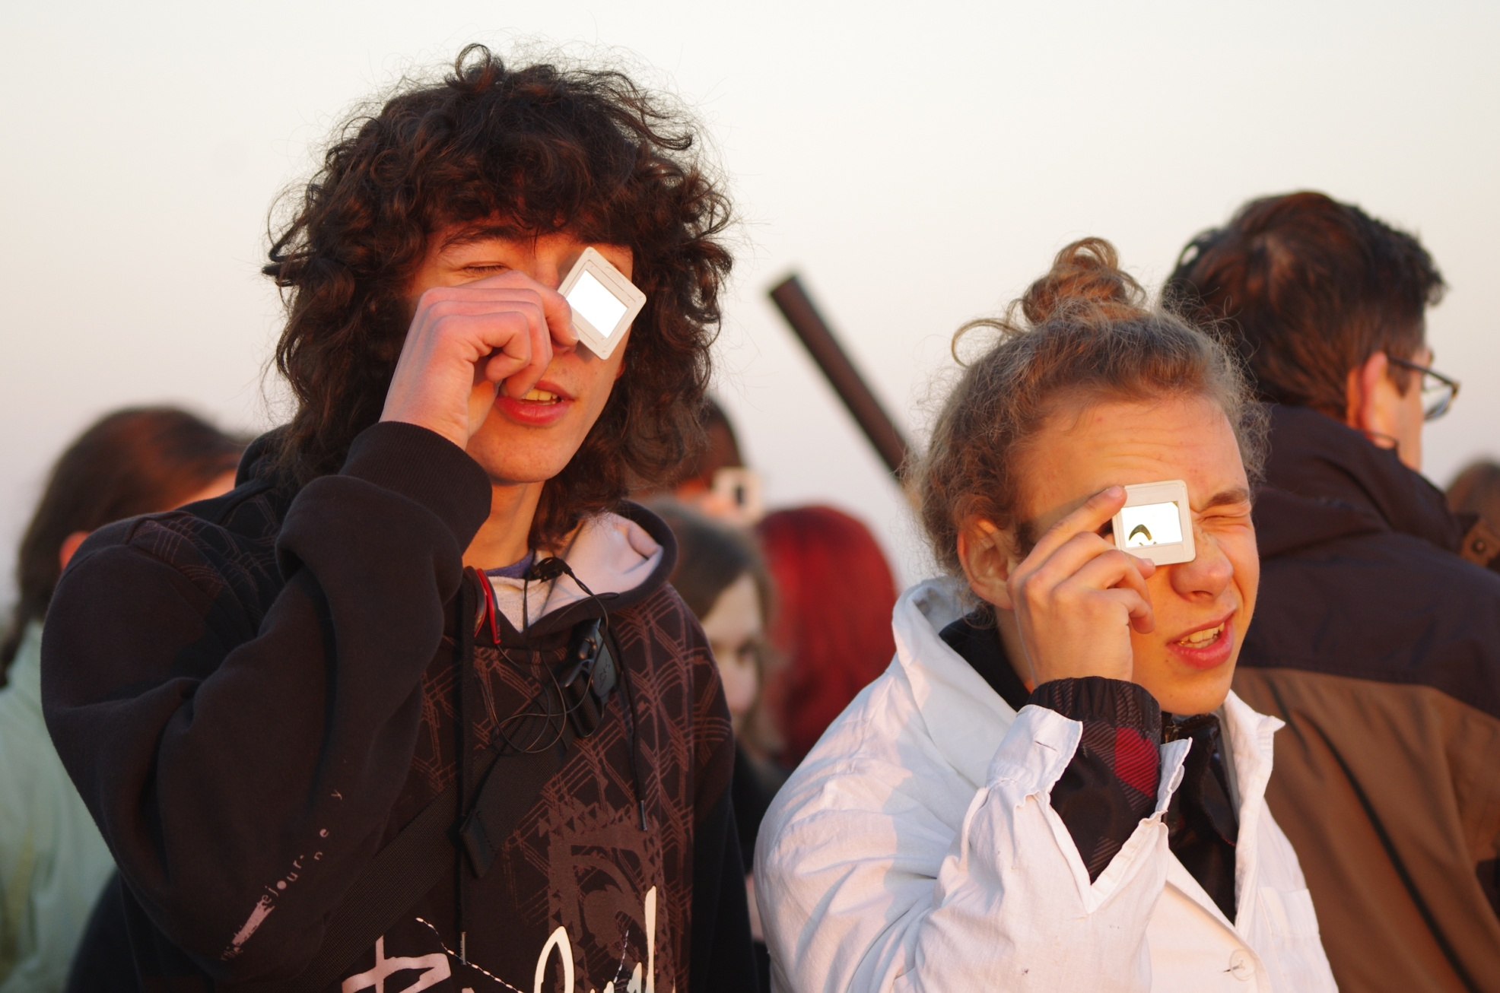
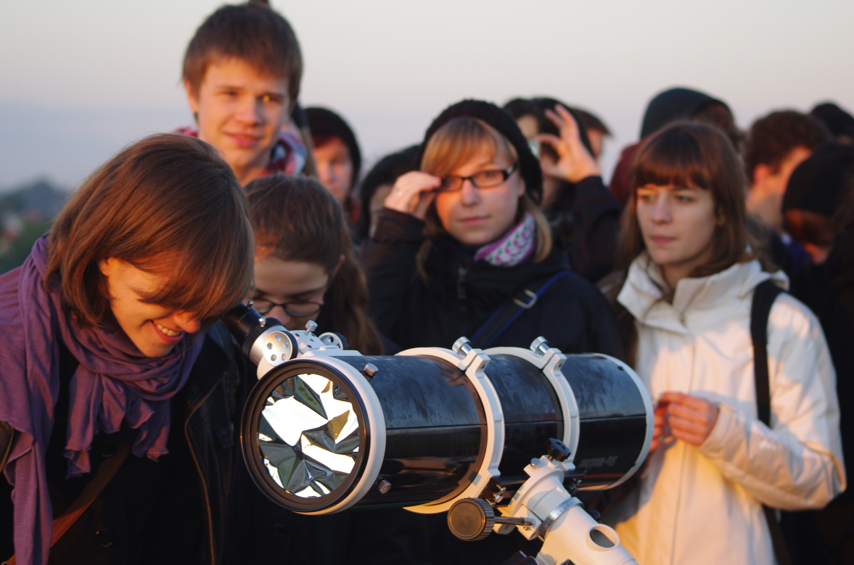
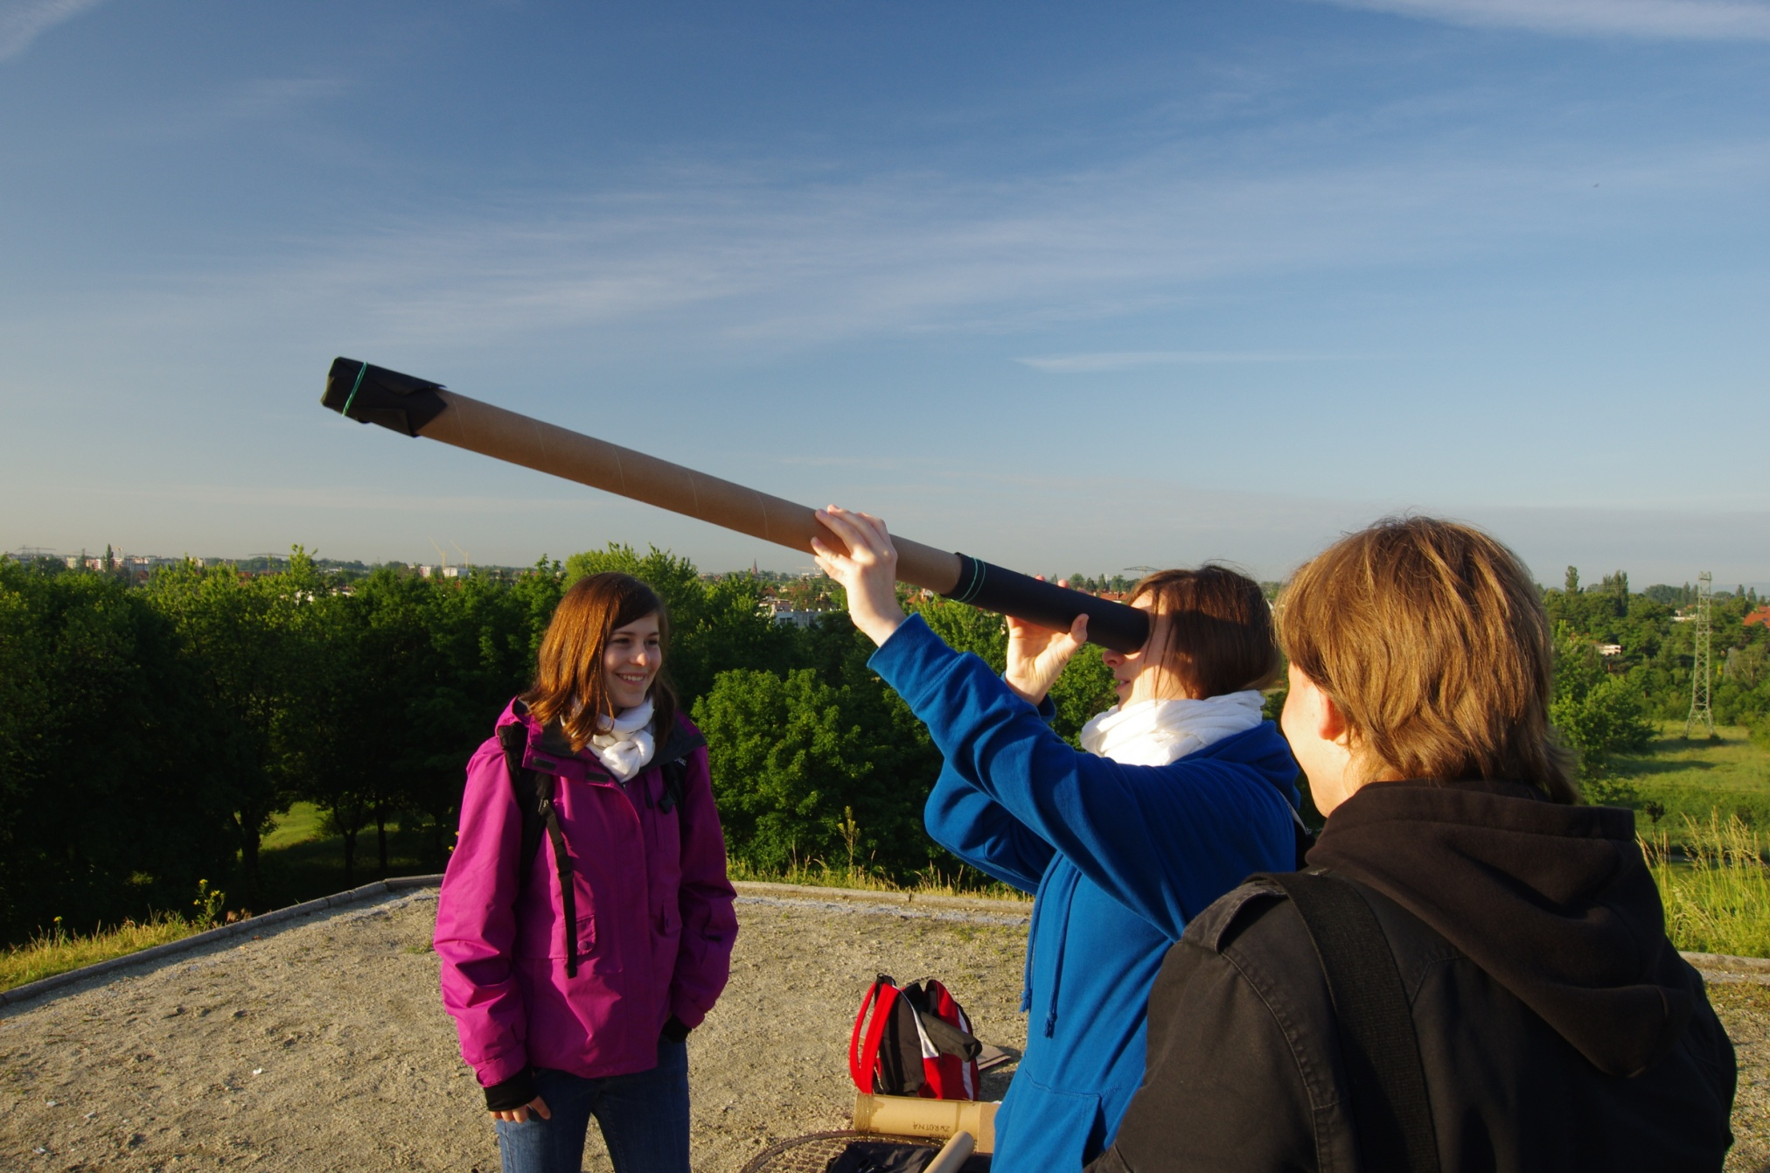
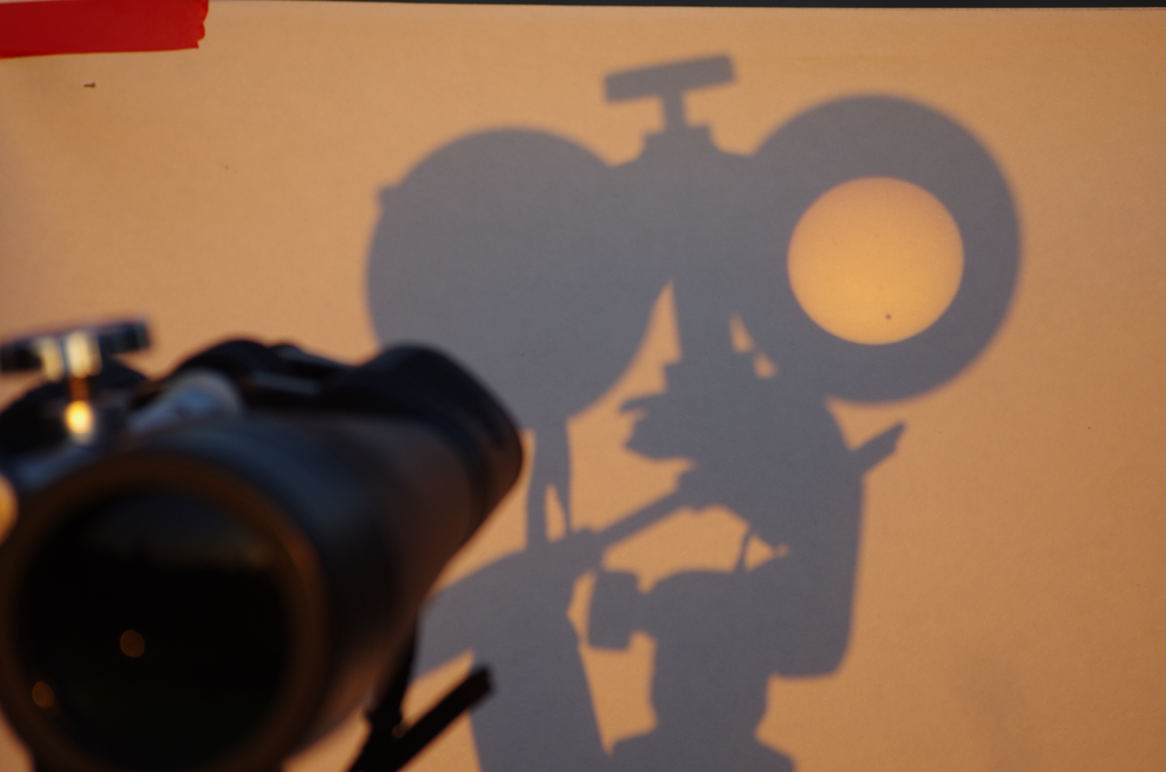
Inne - 6.06.2012 – tranzyt Wenus, wykłady
Notes:
In the frame of SWA I organized watching the transit of Venus 2012 for students and citizens of Wroclaw.

Slide 13
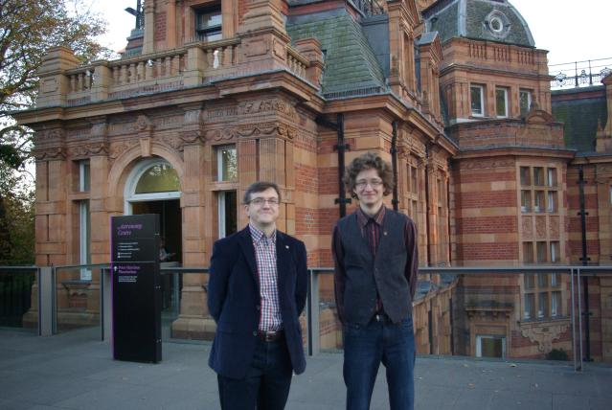
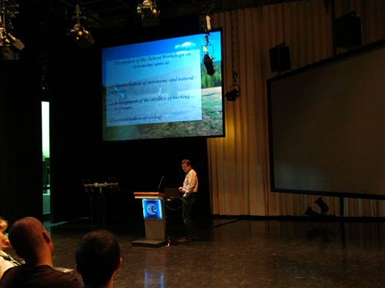
SWA na świecie
IAU General Assembly XXVIII, Beijing 2012
Royal Observatory Greenwich - 22.10.2011
ESA Summer Workshop for Teachers 2012
Notes:
wherever we are, we are talking about the activities and ideas related to the SWA

Slide 14
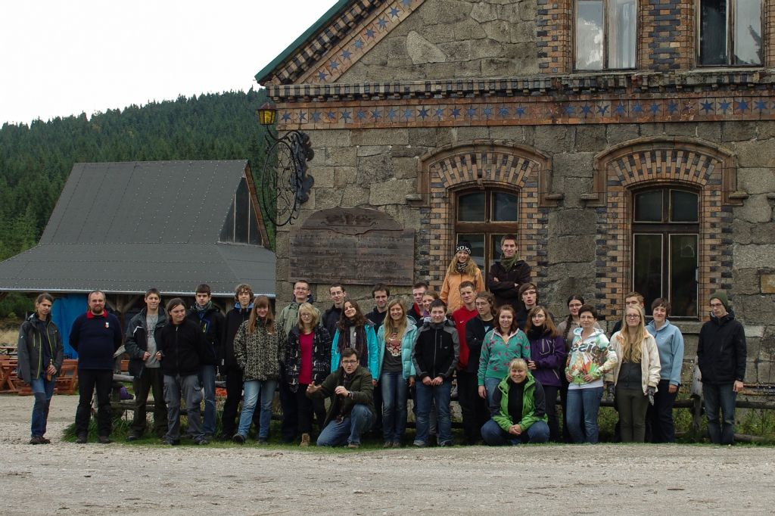
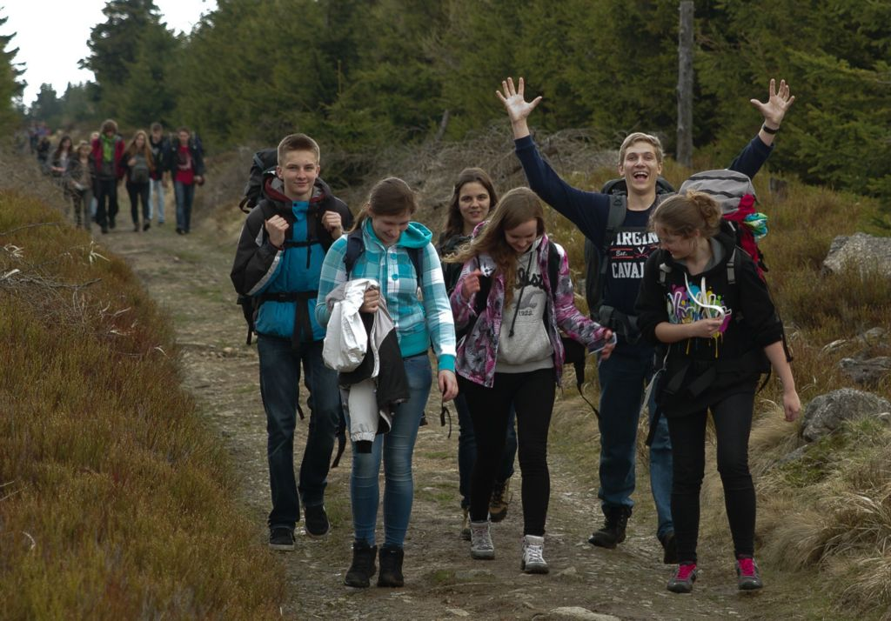
Trochę o warsztatach z perspektywy uczestnika

Slide 15
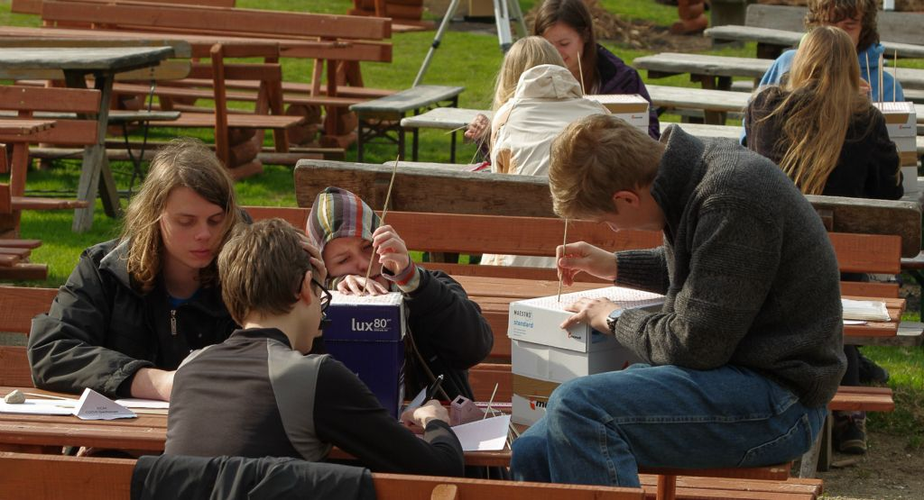
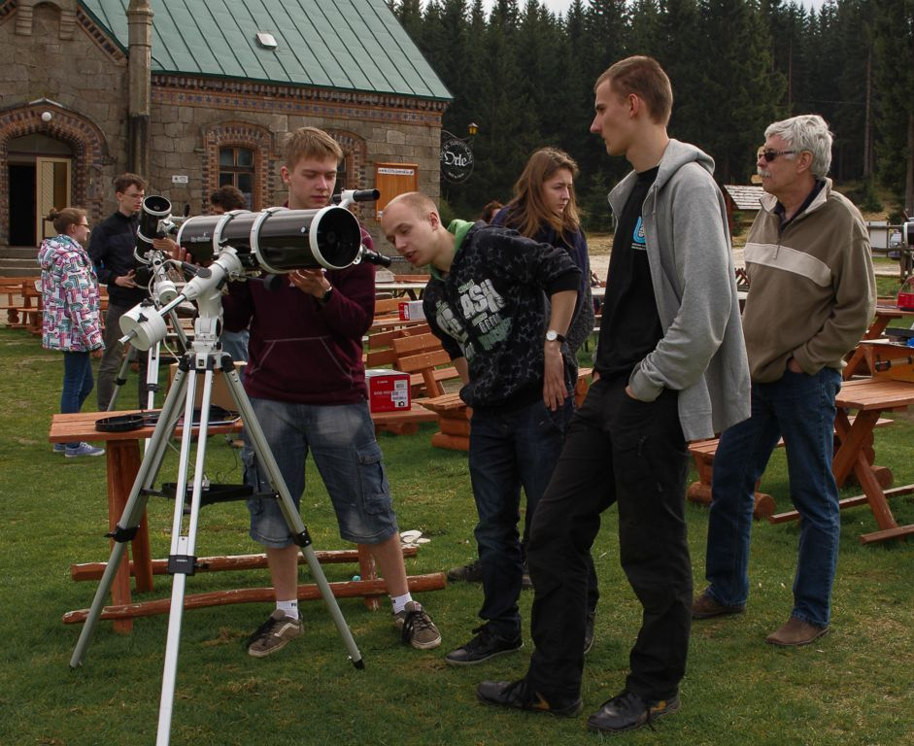
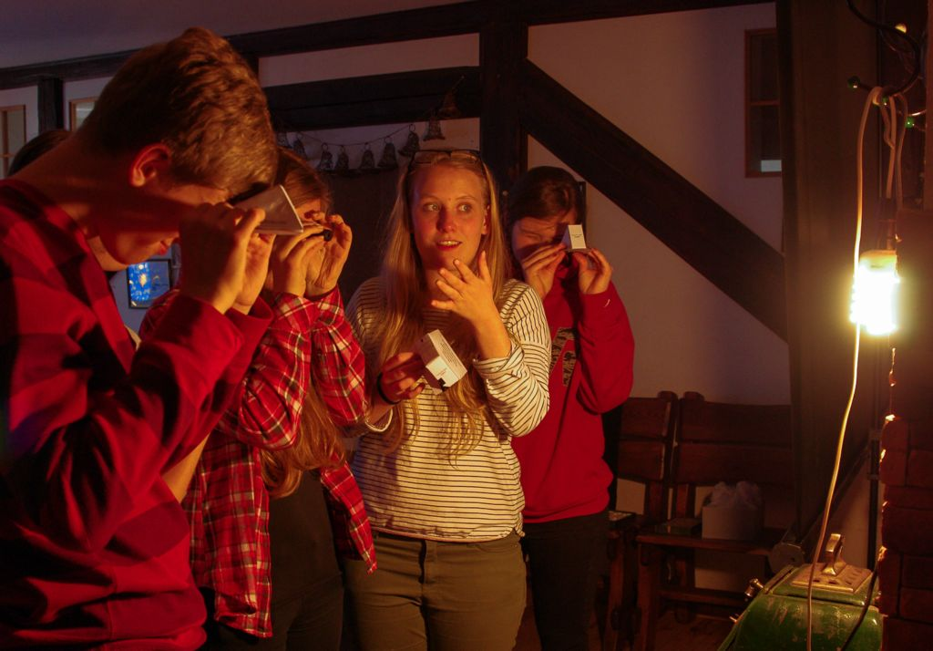
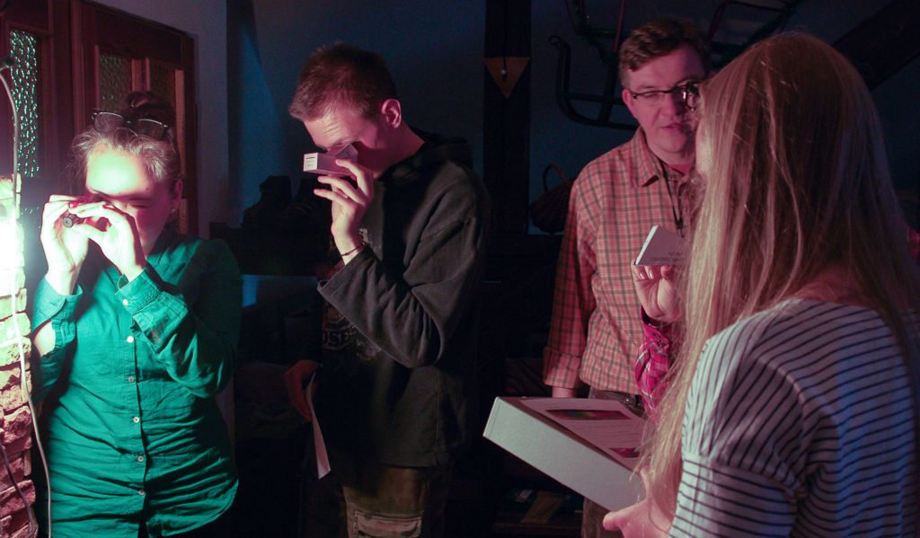
Zajęcia na warsztatach

Slide 16
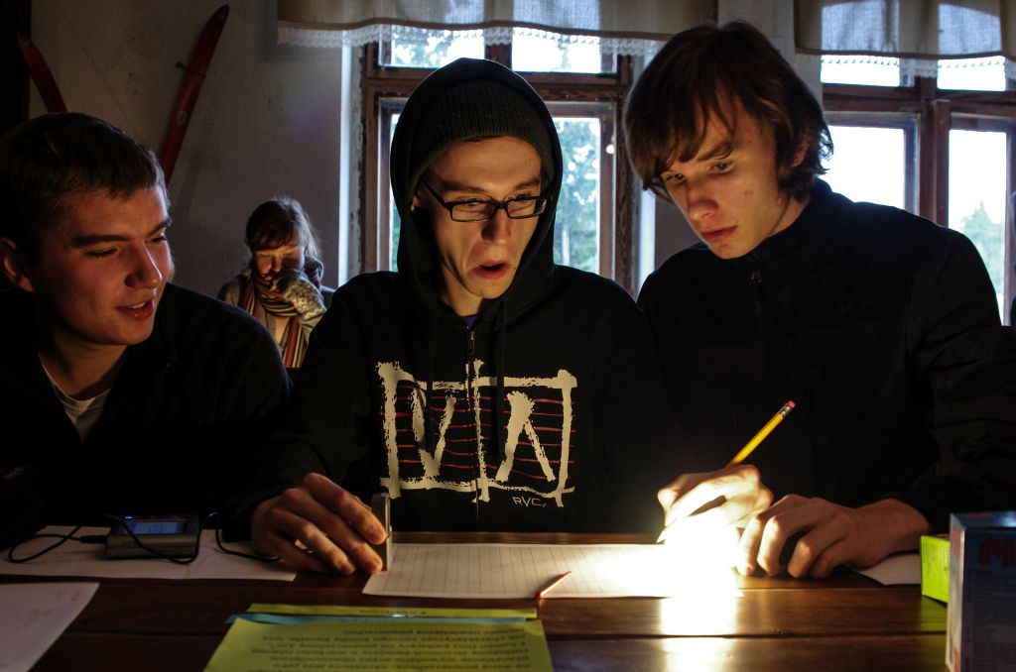
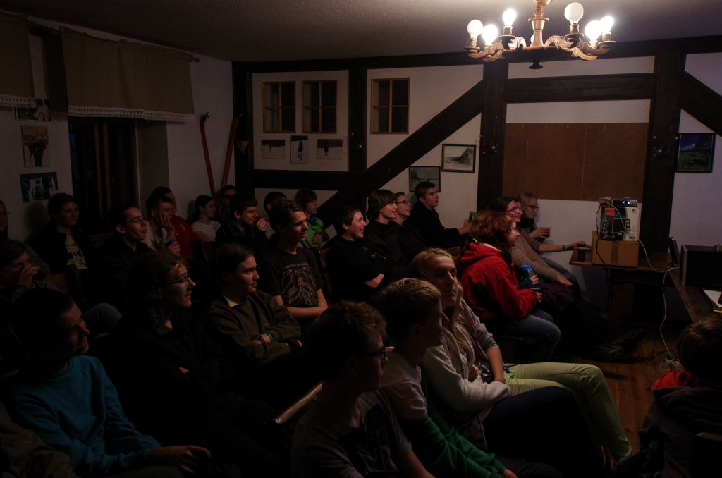
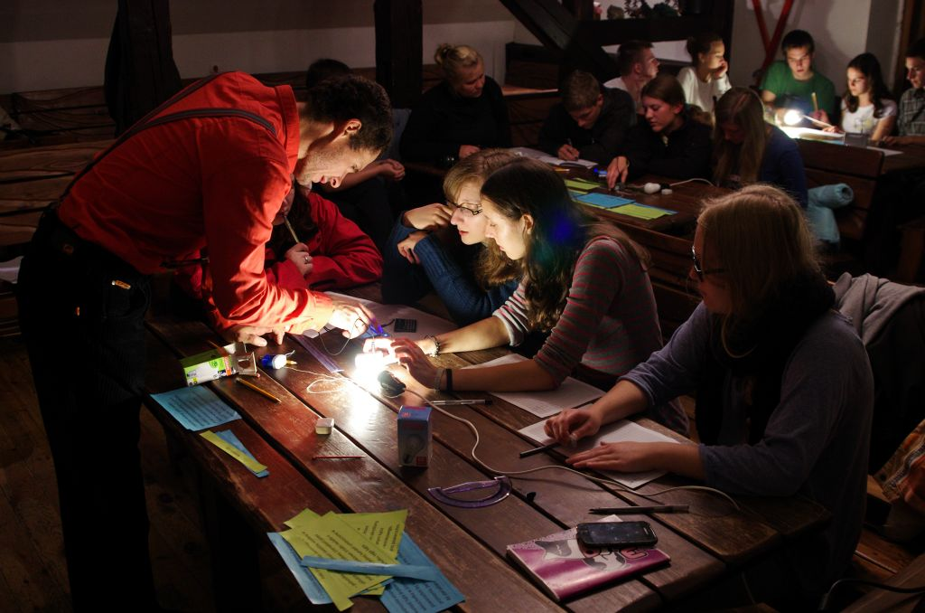
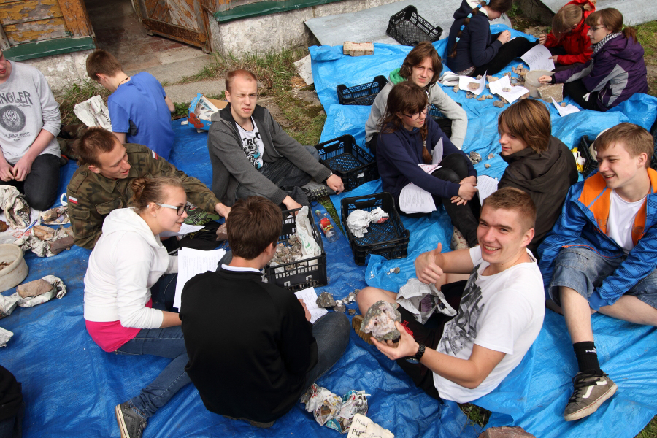

Slide 17
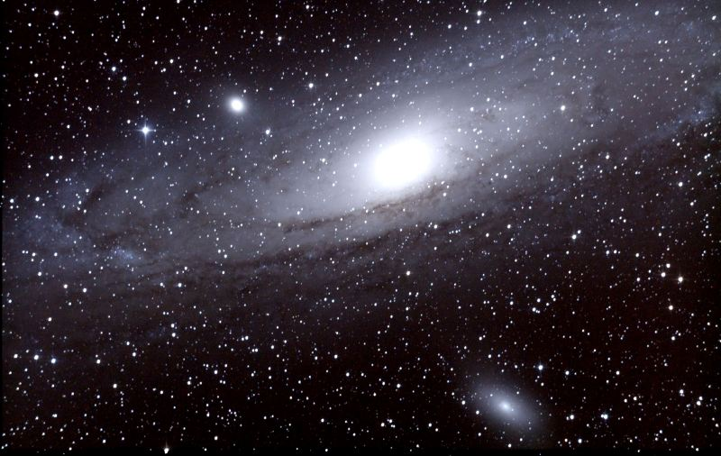
Amatorskie astrofotografie w naszym wykonaniu
Andromeda M31

Slide 18
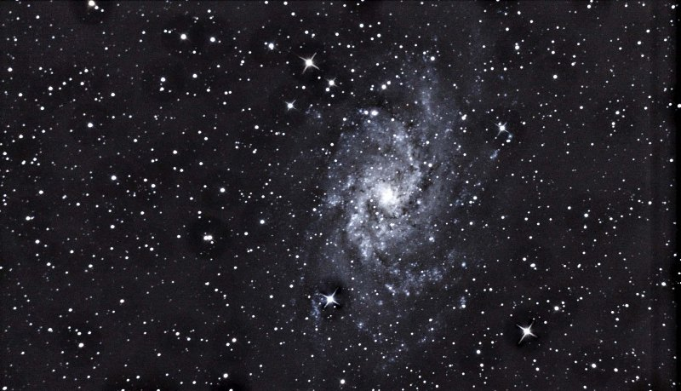
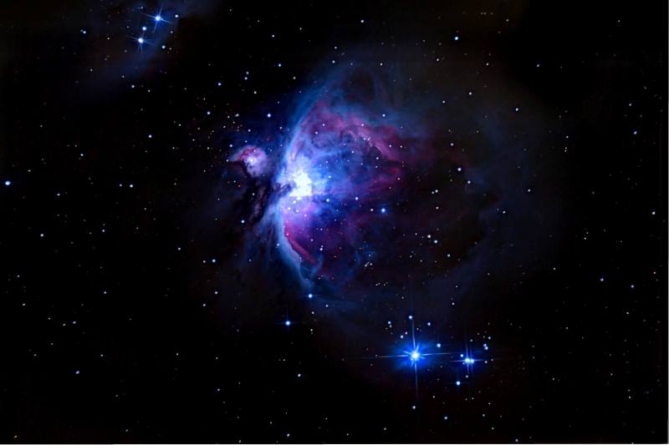
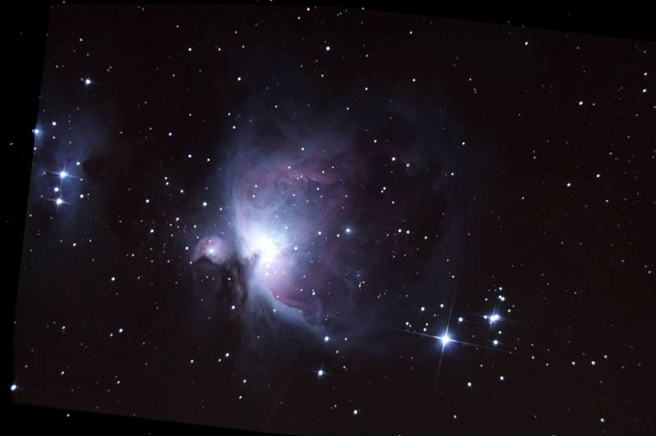
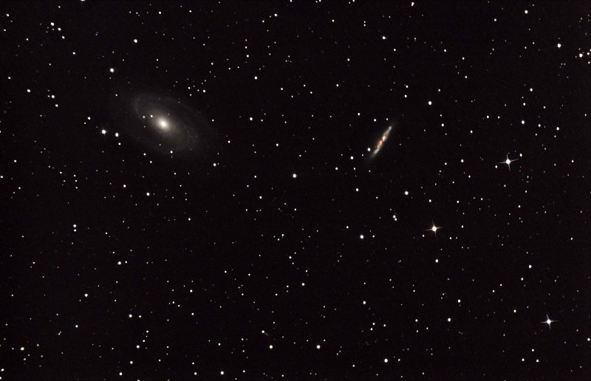
Galaktyka Trójkąta-M33
Mgławica w Orionie M42
Galaktyka Bodego M81 i Cygaro M82

Slide 19
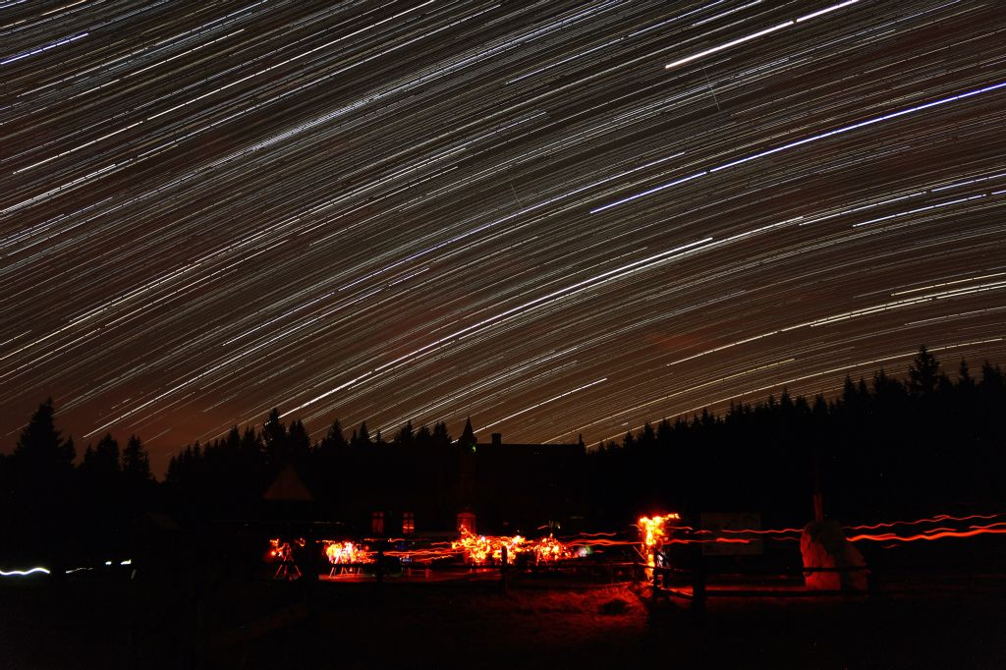
http://www.swa.edu.pl
Dziękujemy za uwagę!

